Slide 1
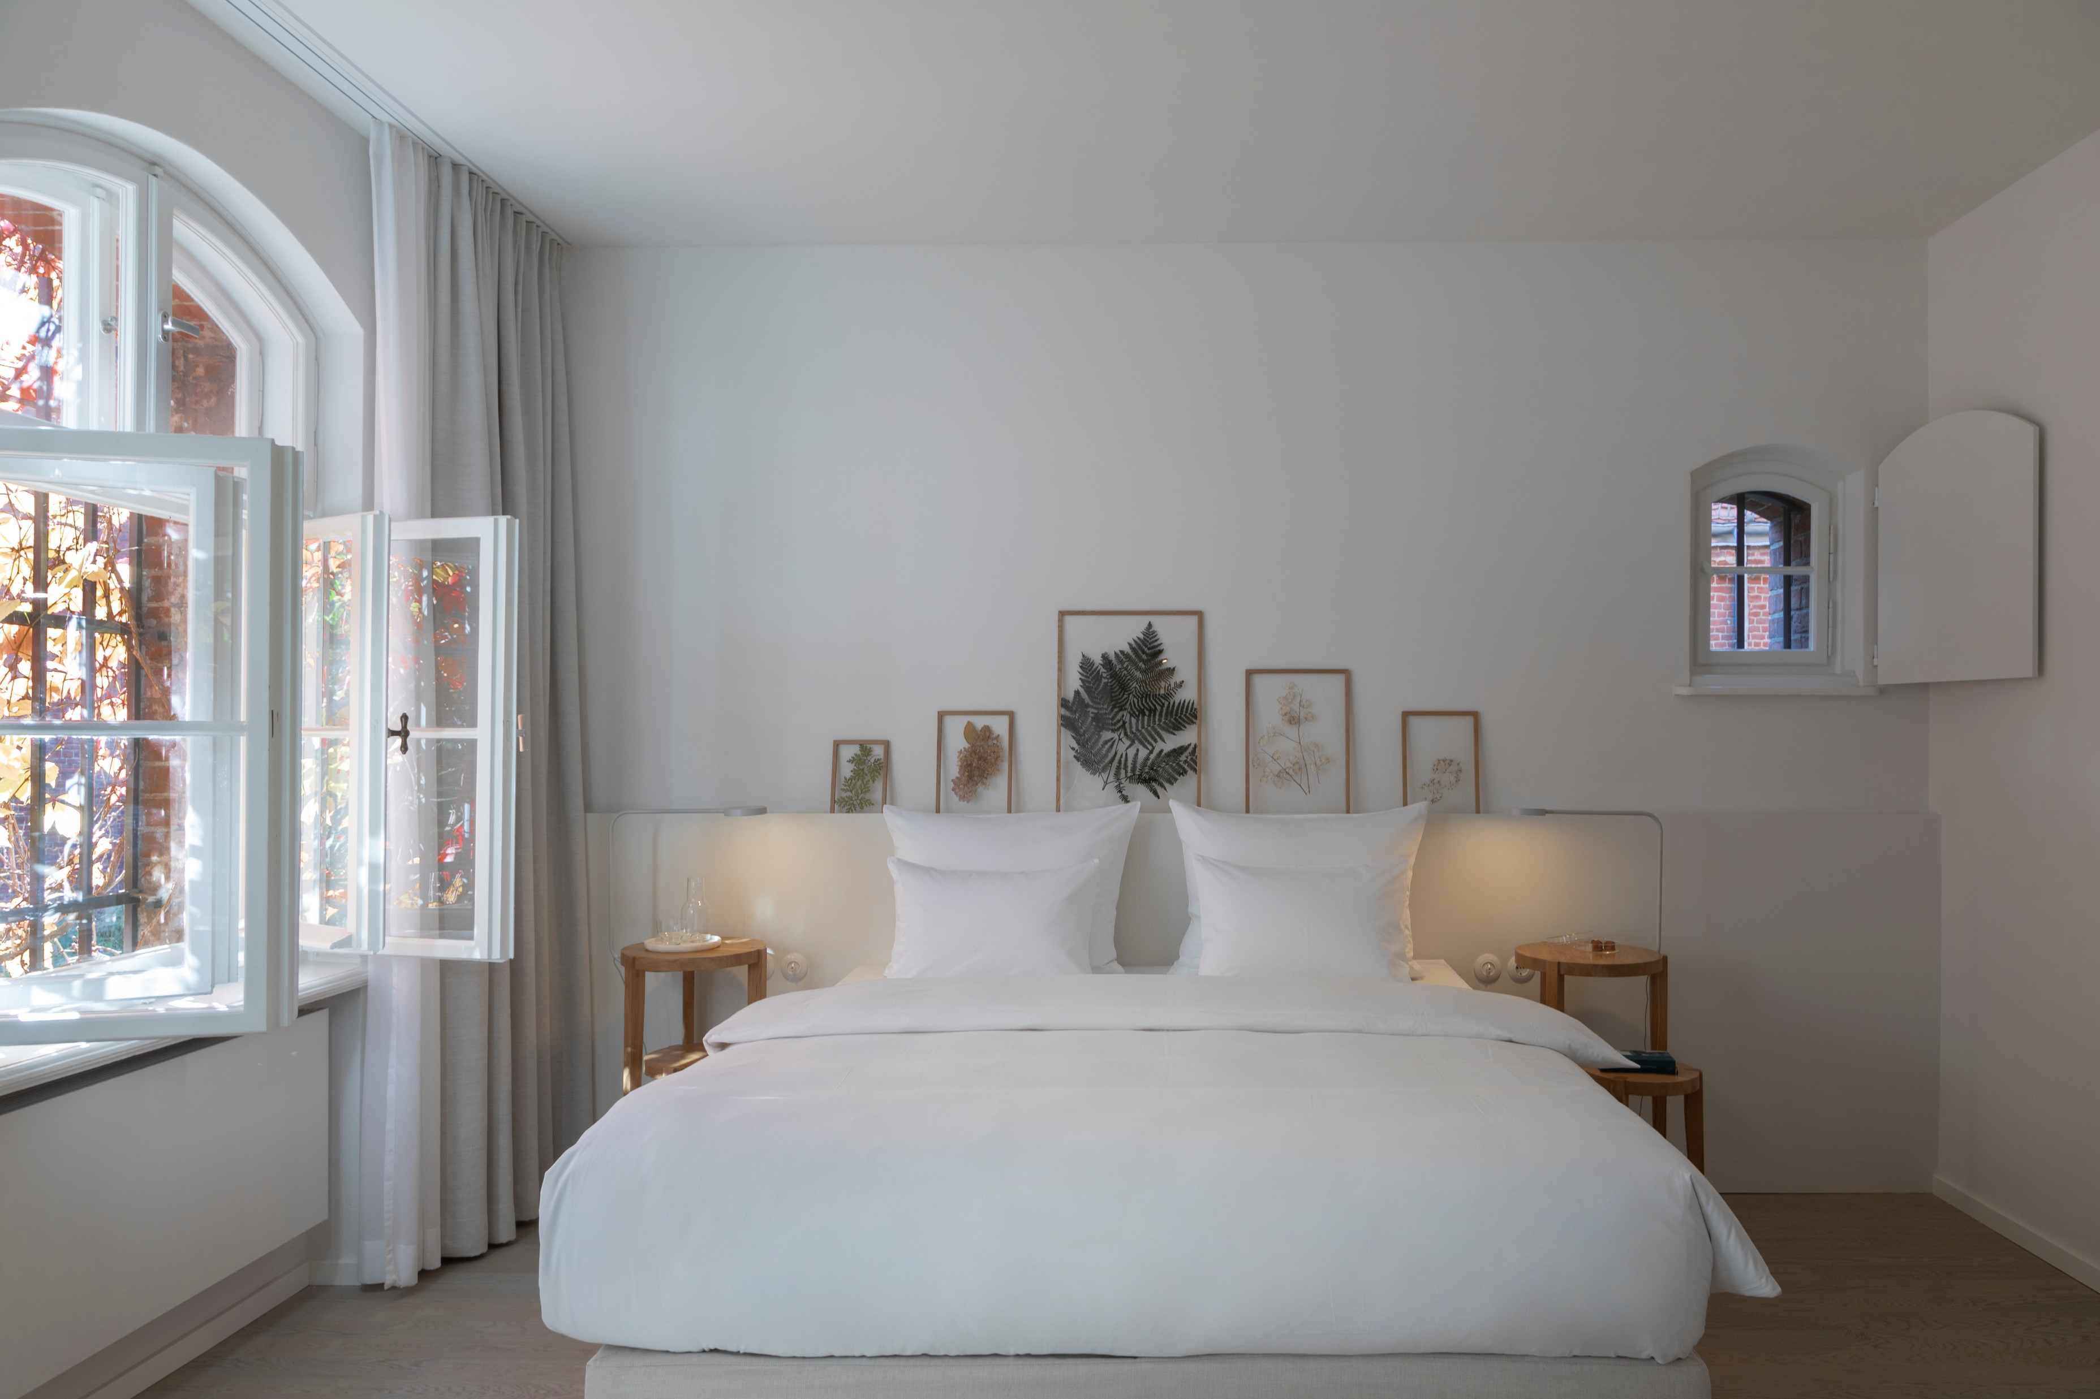
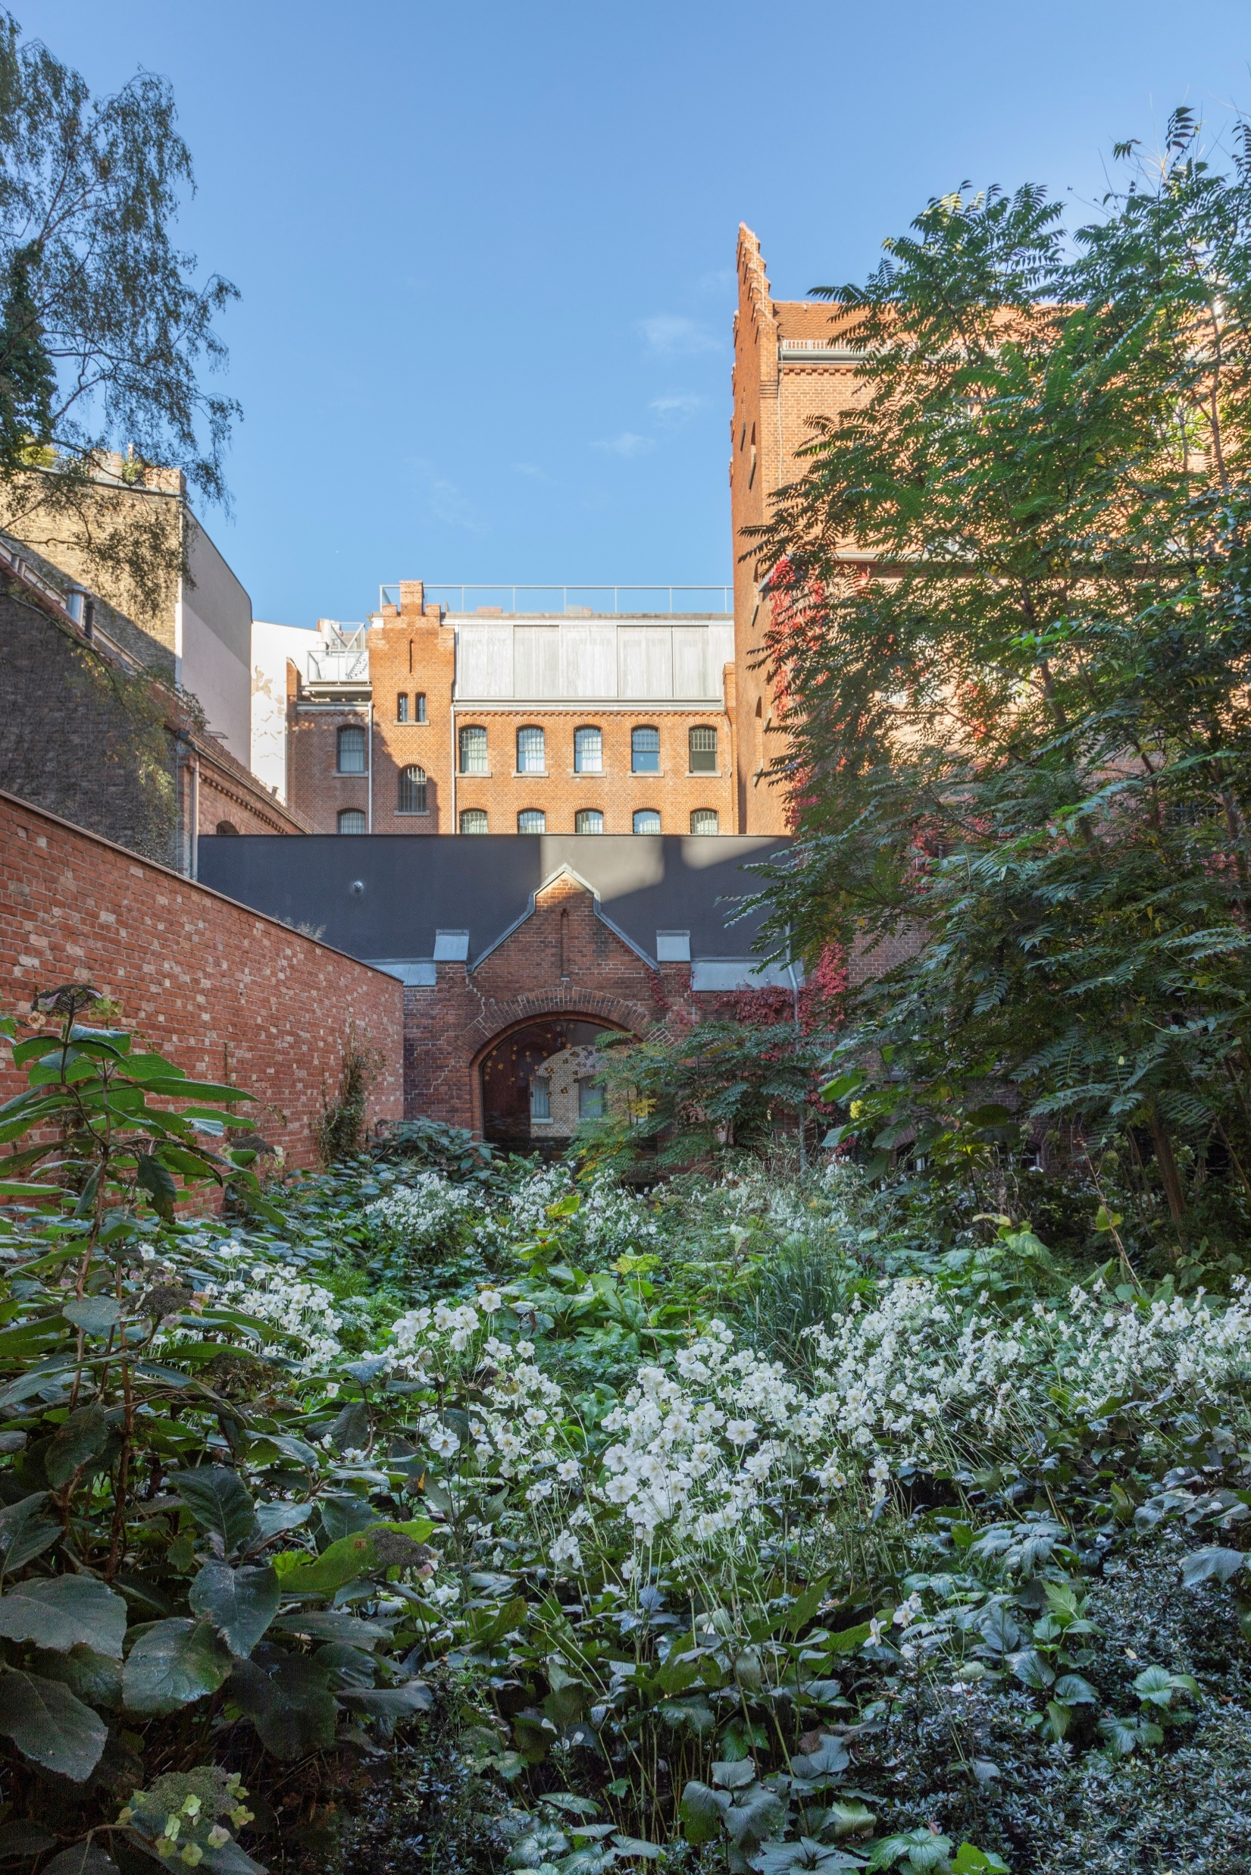
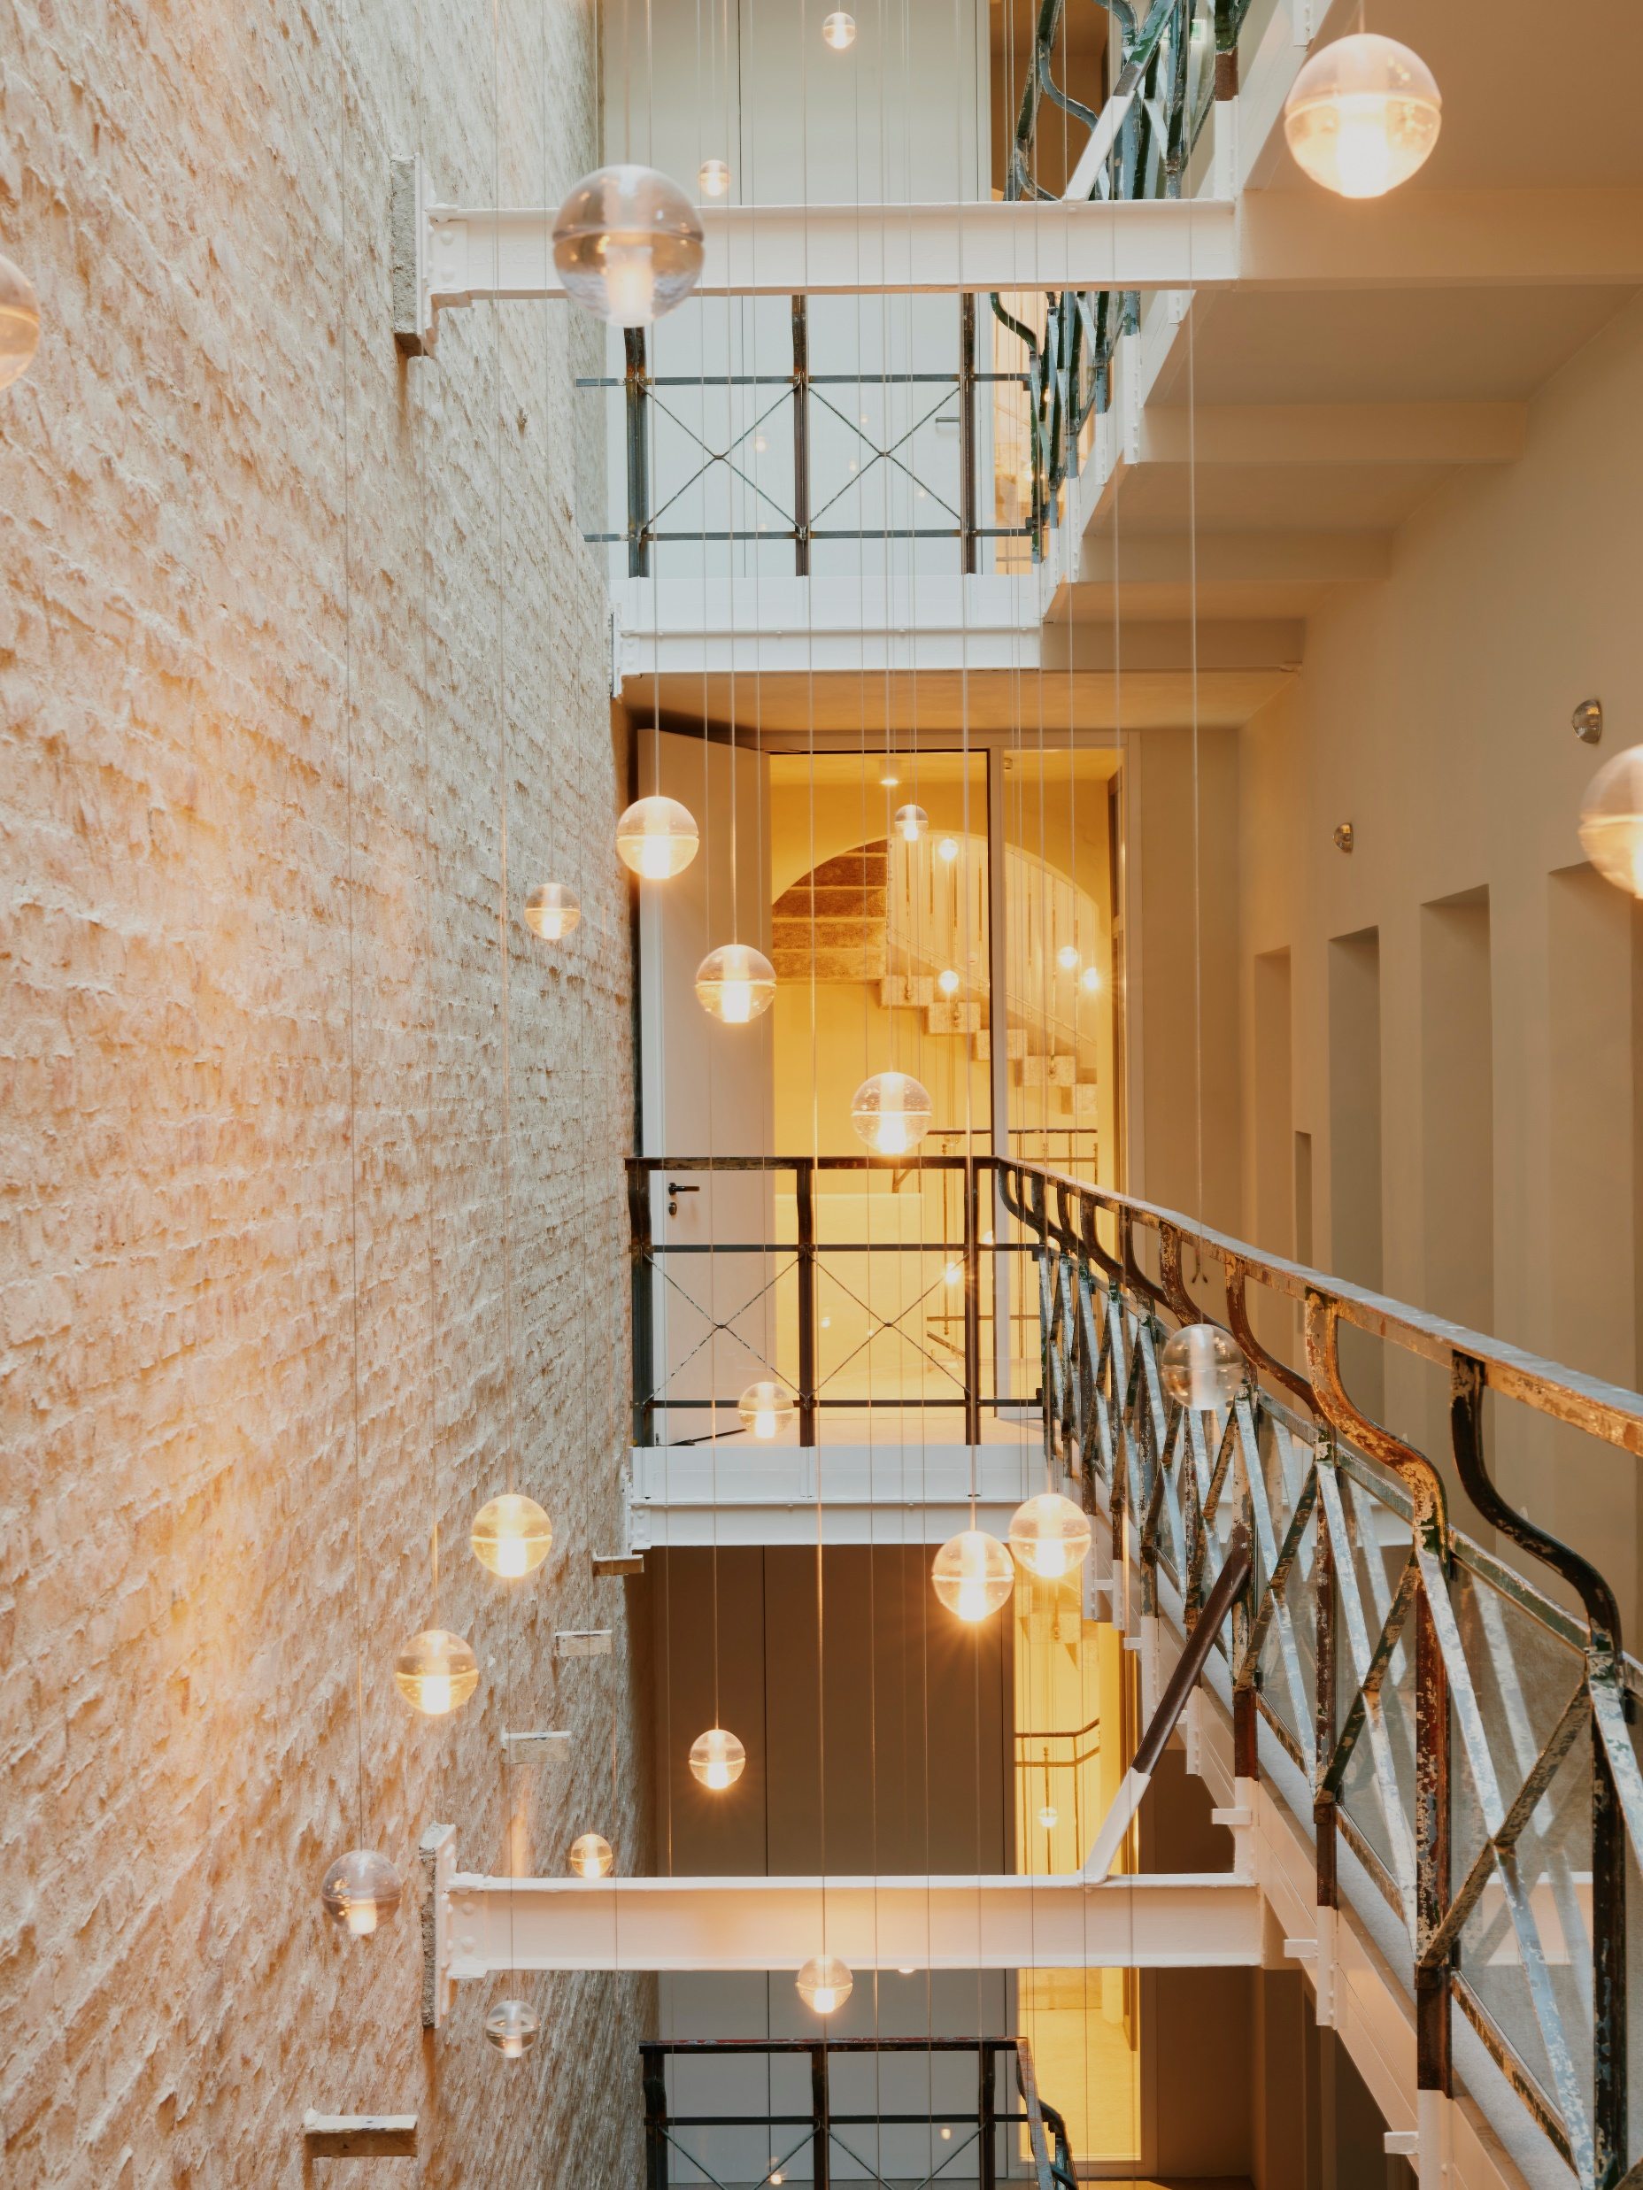
Wilmina GmbH
Winner of the BDA Berlin architecture prize and 196+ hotel of the year 2023, the Wilmina Hotel – member of Design Hotels – offers a high degree of peace and comfort with its 44 rooms and suites, private roof terrace, gardens, library, spa and gym. Wilmina Hotel, an architectural jewel in a former women’s prison, has sensitively been transformed into a sublime hideaway lodging location. The boutique hotel offers far more than a regular hotel. The brand Wilmina disposes over a former courthouse used as a very special event location and the fine-dining restaurant Lovis, run by the renowned chef Sophia Rudolph and her team. Wilmina opened in April 2022.
Germany, Berlin
Julia Werner, Operations Manager
werner@wilmina.com
Wilmina.com
Find us here
https://www.linkedin.com/company/wilmina/
@wilmina
@lovis
@amtsalon

Slide 2
Placement opportunities
Practical Placement
All-round
F&B (fine dining, Service/Kitchen)
Rooms division (FO, Events, HSK)
Starting date: 01.08, 01.09 or earlier
Accommodation may be provided upon request

